Slide 1
Introduction to Computing for Data Analysis
Pairwise association mining
Richard Vuduc, Ph.D.
Associate Professor
School of Computational Science and Engineering
Designing an algorithm 2 From counts to confidence

Slide 2


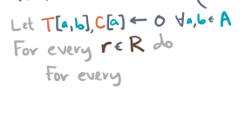


Slide 3


Slide 4






